Slide 1
One Bite at a Time:
Deleting Millions of Rows from Production Systems

Slide 2
About THE Author
Began teaching SQL Server certification classes in 2002
Worked in Microsoft CSS for 10 years
Specialized in performance and storage engine
8 years experience in SQL Server development
Current working at Incomm Payments
Regular SQLSaturday and PASS Summit speaker
Started blogging in 2019 at sqljared.com

Slide 3



Jared
Poche
Database Architect
I’ve worked with SQL Server for 20 years, first in Microsoft CSS and now as a Database Architect focusing on optimization, development and architecture. Currently working at Incomm Payments, a fintech company in the US.
Incomm Payments
@sqljared
/jared-poche
sqljared.com

Slide 4
Batching Major operations
The purpose is to allow larger operations to occur as needed with no interruption of service or significant blocking.
Garbage collection
Data archival
Backfilling new columns
Managing PII (GDPR\CCPA)
Anonymization\obfuscation
Masking\encryption
Batching large queries\reports against OLTP

Slide 5
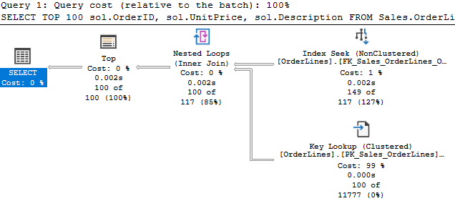
Foundation
What should an efficient TOP plan look like?
Understanding the flow of row mode execution
Common caveats
Blocking operators
Sorts
Conflicting criteria (alignment)
Notes:
Ex 11 - 13

Slide 6
Conflicting Criteria
Typically use an index for one of two reasons:
Index matches filter
Index matches order
But we must choose one

Slide 7
A Simple Garbage Collection Process
Notes:
Examples 11-13

Slide 8
Coding Strategies for GC
Keep it simple
Transactions as necessary
Stop when you can
Consider the negative!
Test your batch size
Parameterize

Slide 9
A Comprehensive Garbage Collection Process
Notes:
Example 21

Slide 10
Updates
Anonymization\obfuscation
Progressively slower
“Not self-cleaning”
Filtered indexes

Slide 11
Inequality Queries
The 30% Estimate
Guesses when no stats are available
May only apply to local variables
Less applicable to complex queries
Indexing an inequality seek
Inequality goes last

Slide 12
Examples
See the attached queries
All examples based on WideWorldImporters
TOP behavior and Flow
Simple garbage collection
Comprehensive garbage collection
Updating with filtered indexes
Inequality estimates

Slide 13
@sqljared
sqljared.com

